Slide 1
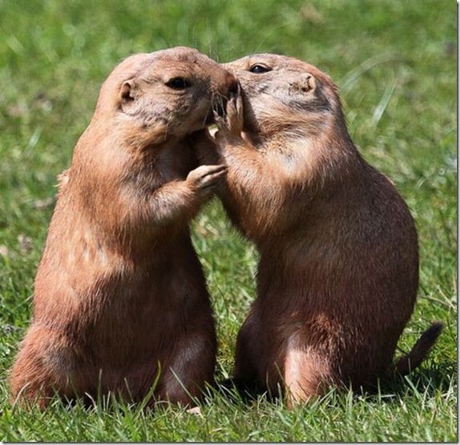
Vowel Phonemes in English and Bahasa Melayu
Supplementary materials for the course:
Reading in English for Young Learners in Malaysia for TELL2

Slide 2

‘Long’ and ‘Short’ Letter Sounds
The ‘short’ sound is NOT like the letter name.
The ‘long’ sound is like the letter name, and may be a long vowel or actually a diphthong.

Slide 3



English “Long ‘a’ ”, “Short ‘a’ ”
Long ‘a’
diphthong
Sounds like the letter name
/eɪ/
a
a-e
ay
ai
baby
tape
tray
snail
ant
Short ‘a’:
/æ/
a

Slide 4

Bahasa Melayu: ‘a’
/ɑ:/
a
banana
ar
car
Sounds like the other English letter ‘a’

Slide 5



English “Long ‘e’ ”, “Short ‘e’ ”
/i:/
e
ea
ee
ey
y
“Long ‘e’ ” sounds like the letter name.
me
beach
tree
key
pony
Forget-me-not
“Short ‘e’ ”
/e/
e
bed
ea
bread

Slide 6
Bahasa Melayu: ‘e’
There are two phonemes for ‘e’:
the sounds/ə/ and /e/
English “Short ‘e’ ” is the same as
one of the BM ‘e’ s.
/e/
e
bed
ea
bread

Slide 7
Bahasa Melayu: ‘i’
/i:/
e
ea
ee
ey
y
me
beach
tree
key
pony
Forget-me-not
English “Long ‘e’ ” is the same as the BM ‘i’

Slide 8

English “Long ‘i’ ”, “Short ‘i’ ”
Long ‘i’:
diphthong
Sounds like the letter name
/ɑı/
i
i-e
igh
y
tiger
kite
light
fly
e
rocket
Short ‘i’:
/ı/
i
tin

Slide 9


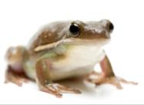
English “Long ‘o’ ”, “Short ‘o’ ”
Long ‘o’:
diphthong
Sounds like the letter name
/əʊ/
o
oa
o-e
ow
ew
go
boat
note
snow
sew
Short ‘o’:
/ɒ/
o
frog
wa
swan

Slide 10
Bahasa Melayu: ‘o’
/ɒ/
o
frog
wa
swan
Sounds like English “Short ‘o’ ”

Slide 11


English “Long ‘u’ ”, “Short ‘u’ ”
Long ‘u’:
diphthong
Sounds like the letter name
/u:/
oo
moon
screw
ue
glue
ew
/ʌ/
u
bus
o
glove
Short ‘u’:

Slide 12

Bahasa Melayu: ‘u’
/ʊ/
oo
book
u
bull
In English, it’s another kind of “Short ‘u’ ”.

Slide 13



another English Vowel Sound
/ɔ:/
or
a
au
aw
oor
fork
ball
sauce
saw
door
It’s like a lengthened “Short ‘o’ ”

Slide 14

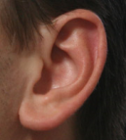


(other) English Diphthongs (1)
/eə/
air
hair
are
square
/ɪə/
ear
deer
ear
eer
/ʊə/
oor
our
ure
ur
moor
tourist
cure
jury

Slide 15


(other) English Diphthongs (2)
/ɑʊ/
ow
cow
ou
house
/ɔı/
oy
toy
oi
coin

Slide 16

The Long ‘er’
This is similar to the second ‘e’ phoneme in BM.
In English it is found in stressed syllables
and words with one syllable.
/ɜ:/
er
ir
or
ur
fern
worm
fur
shirt

Slide 17



The Schwa
In an unstressed syllable the vowel sound is often replaced by ‘schwa’. It is shorter than the similar BM sound.
er
ar
or
ure
teacher
collar
doctor
measure
/ə/
a
e
i
o
u
zebra
garden
fossil
lion
circus

