Slide 1
Interactive Learning Activities

Slide 2
Making use of elements of:
Fun
Example
Competition
Cooperation
Variety of learning styles
Authentic communication
Drilling important information
Change of presentation style
Interactive Learning Activities

Slide 3
What Are You Doing?

Slide 4
I Like People Who...

Slide 5
I Went Hunting...

Slide 6
Running Dictation

Slide 7
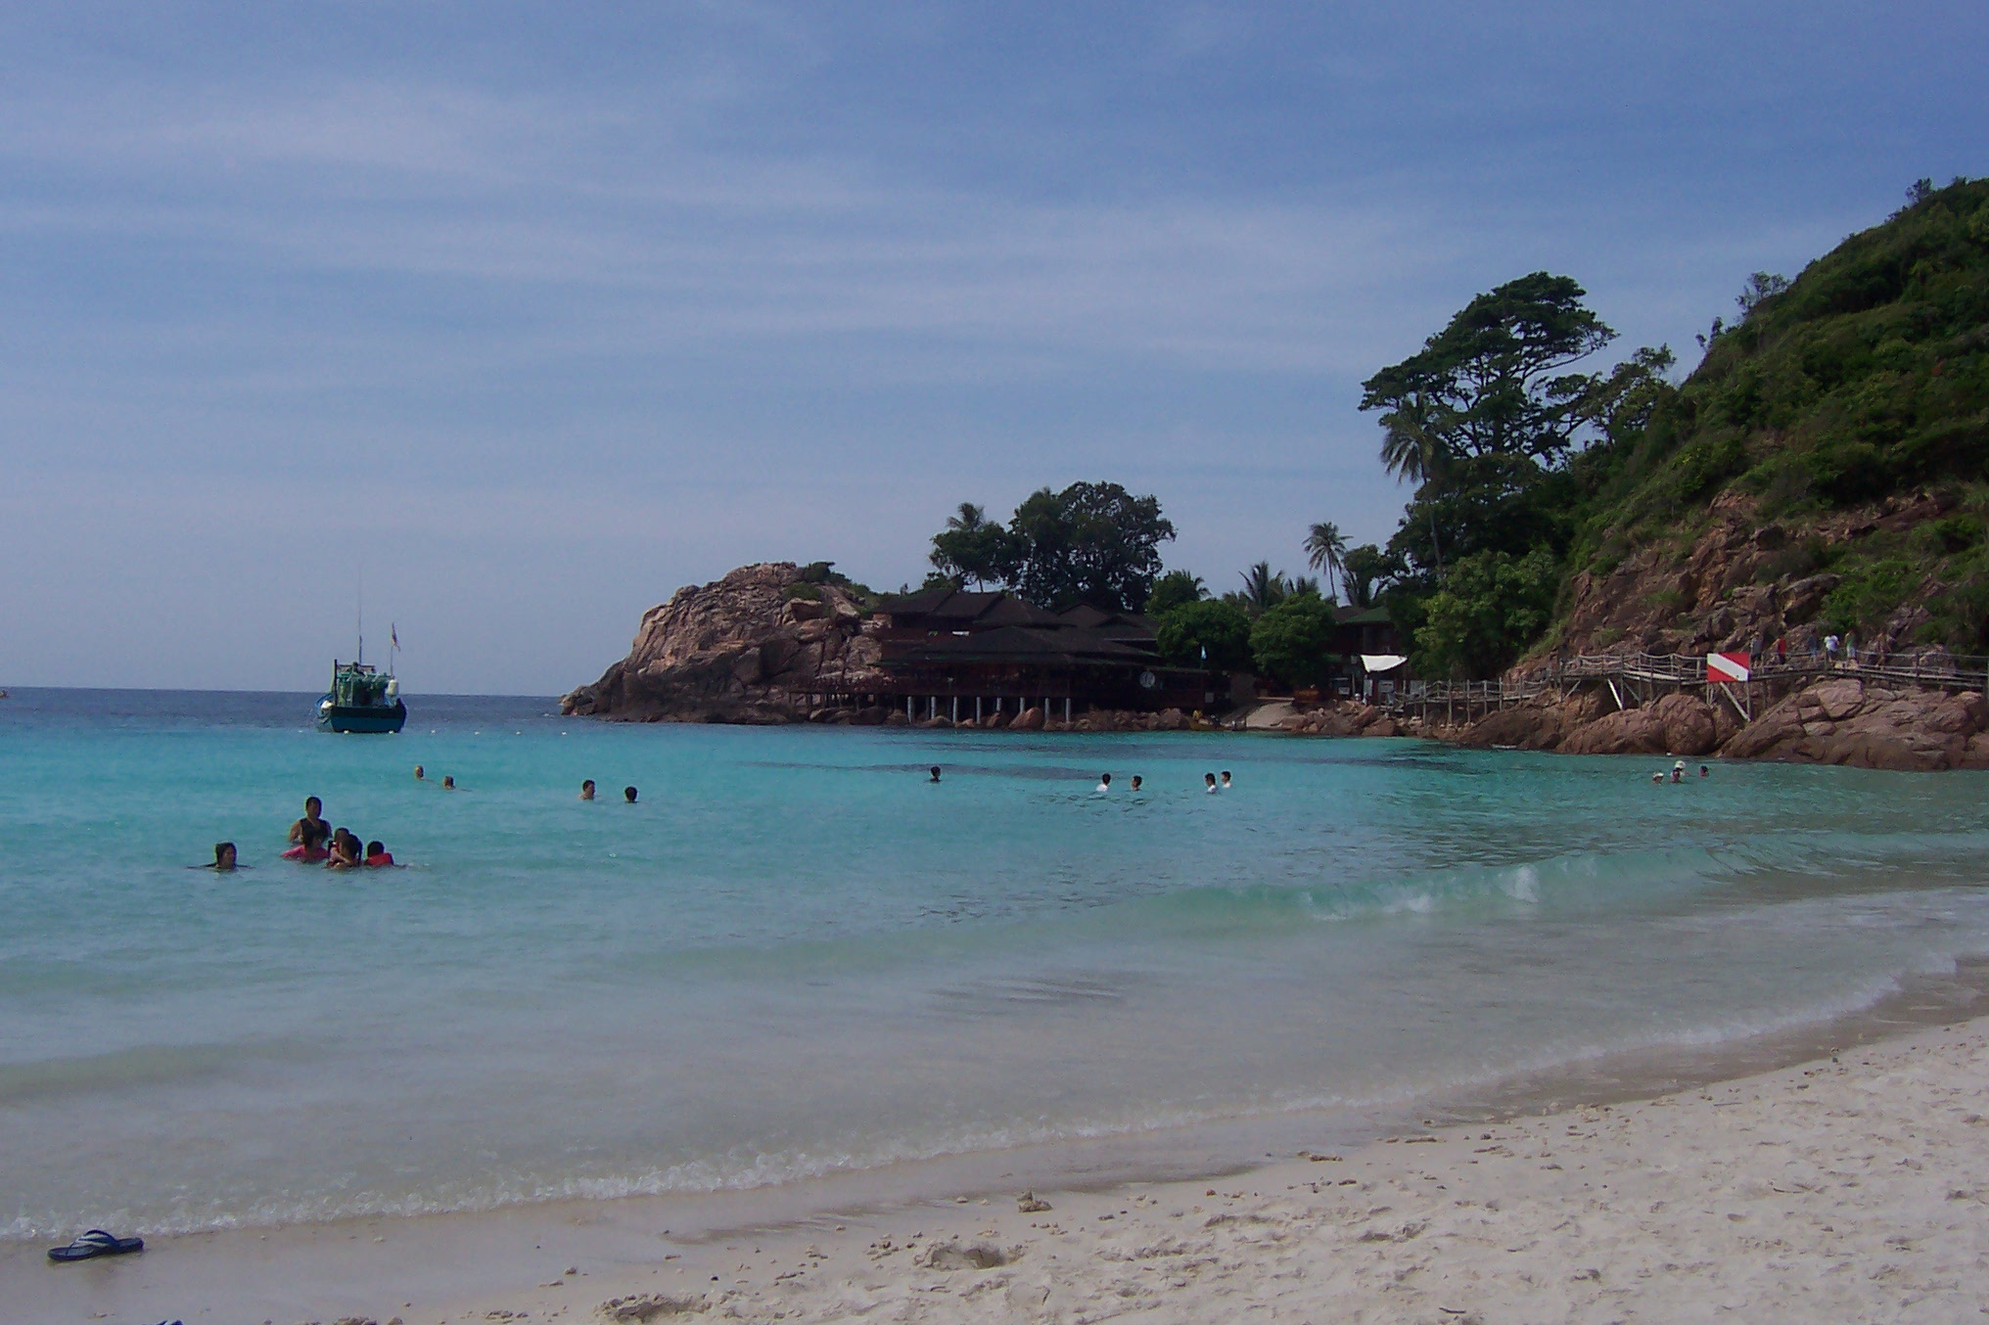
Running Dictation
Using Phonemic Script

Slide 8
1. tu: noʊ mə’leɪʒə ɪz tu: lʌv mə’leɪʒə
ə ‘bʌblɪŋ ‘bʌslɪŋ ‘meltɪŋ pɒt ɒv ‘reɪsəz ænd rə’lɪʤənz weə mə’leɪz ‘ɪndjənz ‘ʧaɪni:z ənd ‘meni: ‘ʌðə ‘eθnɪk gru:ps lɪv tə’geðʌ ɪn pi:s ənd ‘hɑ:mɒni:
fɔ: ðə ‘pɜ:fekt ‘hɒlɪdeɪ fʊl ɒv sə’praɪzəz ek’lektɪk ‘kʌlʧɜ:z ənd ‘næʧərʊl ‘wʌndɜ:z ðə teɪm ɪz naʊ ðə pleɪs ɪz mə’leɪʒə

Slide 9
2. mʌltɪ’kʌlʧɜ:rəlɪzm hæz nɒt ‘oʊnli: meɪd mə’leɪʒə ə gæstrə’nɒmɪk ‘pærədaɪs
ɪt hæz ‘ɔ:lsoʊ meɪd mə’leɪʒə hoʊm tu: ‘hʌndrədz ɒv ‘kʌlʧɜ:rəl ‘festɪvəlz
æz ə ‘pi:pəl mə’leɪʒənz ɑ: ‘veri: leɪd bæk wɔ:m ænd ‘frendli:
fɔ: ðə ‘pɜ:fekt ‘hɒlɪdeɪ fʊl ɒv sə’praɪzəz ek’lektɪk ‘kʌlʧɜ:z ənd ‘næʧərʊl ‘wʌndəz ðə teɪm ɪz naʊ ðə pleɪs ɪz mə’leɪʒə

Slide 10
3. ʤɪjɒˈgræfɪkəli: mə’leɪʒə ɪz æz daɪ’vɜ:s æz ɪts ‘kʌlʧɜ:
ðeə ɑ: tu: pɑ:ts tu: ðə ‘kʌntri:
e’levən steɪts ɪn ðə pə’nɪnsʊlə ɒv mə’leɪʒə ænd tu: steɪts ɒn ðə ‘nɔ:ðɜ:n pɑ:t ɒv ‘bɔ:nɪoʊ
ku:l ‘haɪdəweɪz ɑ: faʊnd ɪn ðə ‘haɪləndz ðæt roʊl daʊn tu: wɔ:m ‘sændi: ‘bi:ʧəz ənd rɪʧ ‘hju:mɪd ‘mæŋgroʊvz
fɔ: ðə ‘pɜ:fekt ‘hɒlɪdeɪ ðə teɪm ɪz naʊ ðə pleɪs ɪz mə’leɪʒə

Slide 11
4. wʌn ɒv mə’leɪʒəz ki: ʌ’trækʃənz ɪz ɪts eks’tri:m ‘kɒntrɑ:sts
‘taʊwərɪŋ ‘skaɪskreɪpez lʊk daʊn ʌ’pɒn ‘wʊdən ‘haʊzez bɪlt ɒn stɪlts
ənd ‘faɪv-stɑ: hoʊ’telz sɪt ‘sevrəl ‘mi:tɜ:z ʌ’weɪ frɒm ‘eŋʃənt ri:fs
fɔ: ðə ‘pɜ:fekt ‘hɒlɪdeɪ fʊl ɒv sə’praɪzəz ek’lektɪk ‘kʌlʧɜ:z ənd ‘næʧrʊl ‘wʌndəz
ðə teɪm ɪz naʊ ðə pleɪs ɪz mə’leɪʒə.

Slide 12
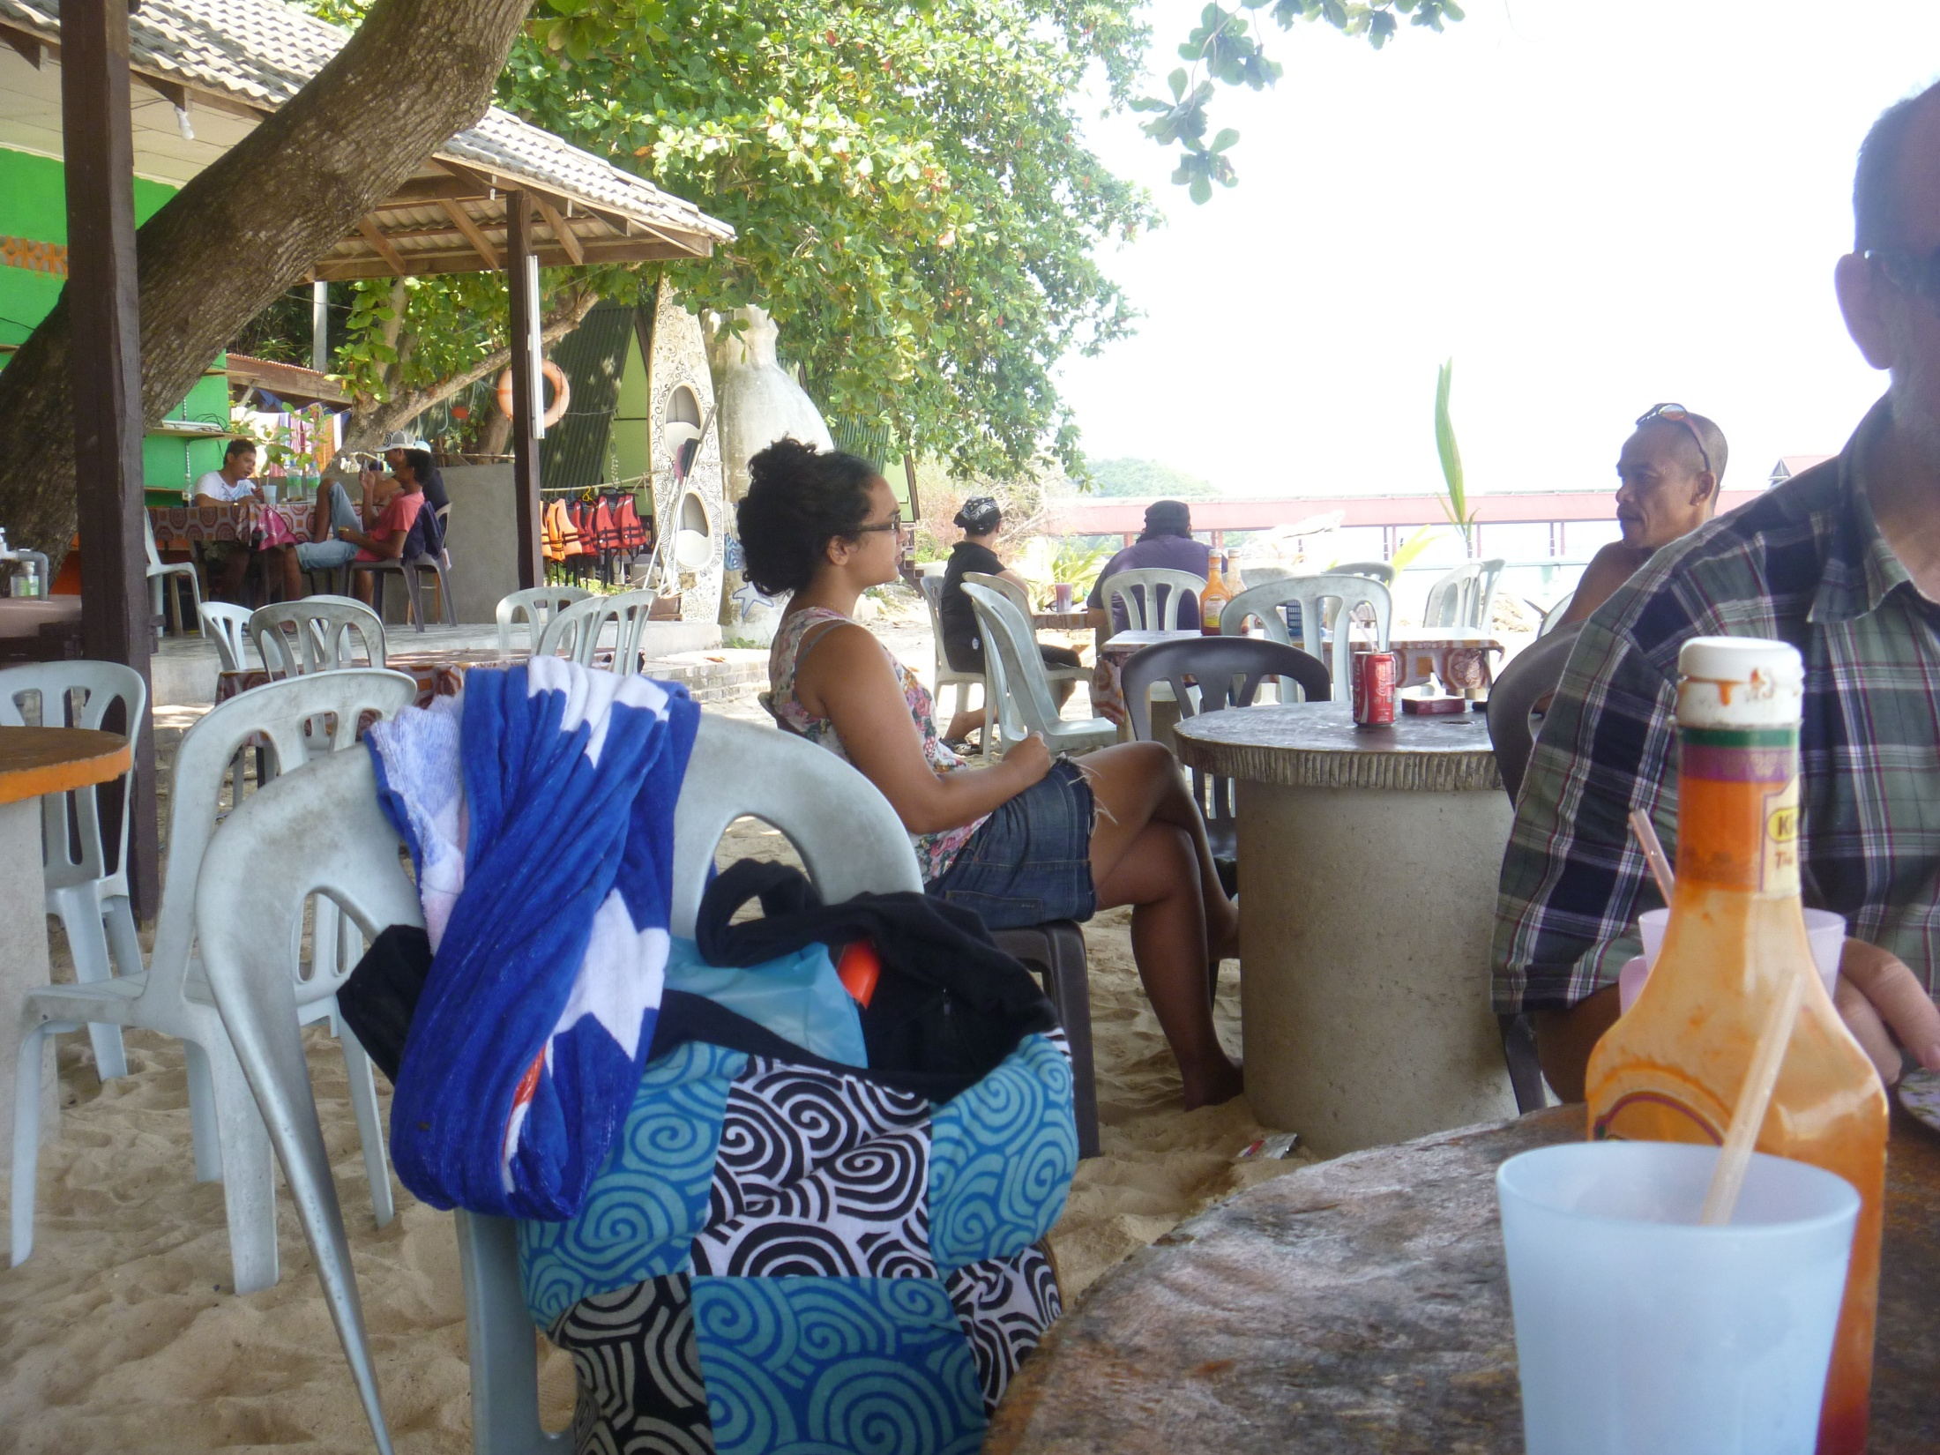
1. To know Malaysia is to love Malaysia, a bubbling, bustling melting pot of races and religions where Malays, Indians, Chinese and many other ethnic groups live together in peace and harmony. For the perfect holiday full of surprises, eclectic cultures and natural wonders, the time is now, the place is Malaysia.

Slide 13
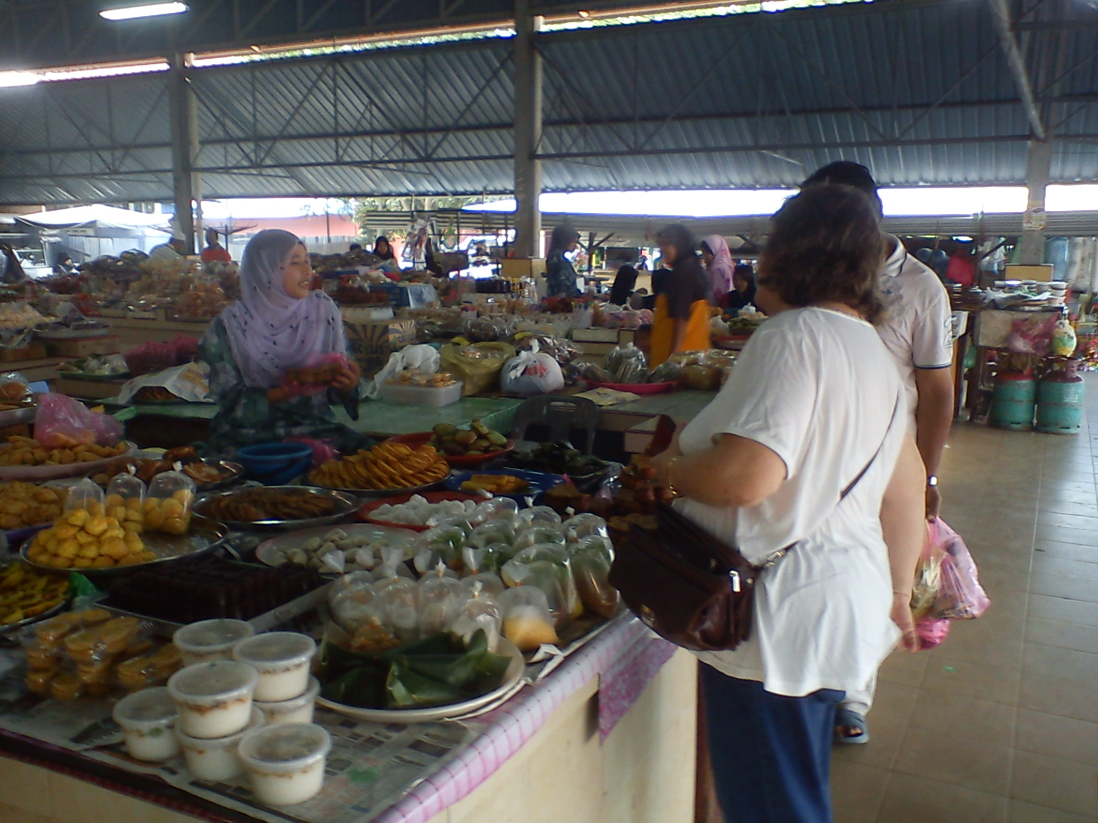
2. Multiculturalism has not only made Malaysia a gastronomic paradise, it has also made Malaysia home to hundreds of colourful festivals. As a people, Malaysians are very laid back, warm and friendly. For the perfect holiday full of surprises, eclectic cultures and natural wonders, the time is now, the place is Malaysia.

Slide 14
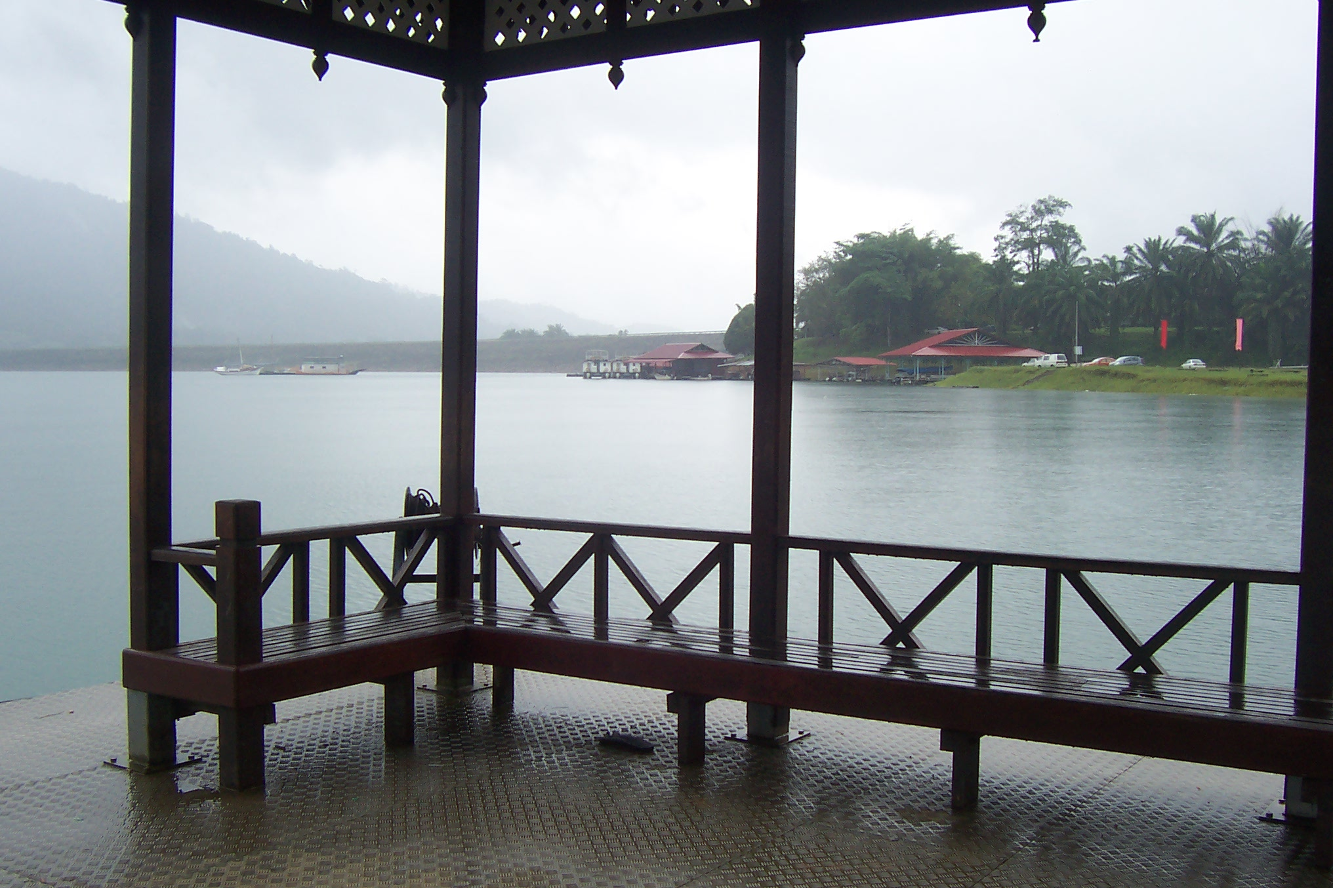
3. Geographically, Malaysia is as diverse as its culture. There are two parts to the country, 11 states in the peninsula of Malaysia and two states on the northern part of Borneo. Cool hideaways are found in the highlands that roll down to warm, sandy beaches and rich, humid mangroves. For the perfect holiday, the time is now, the place is Malaysia.

Slide 15
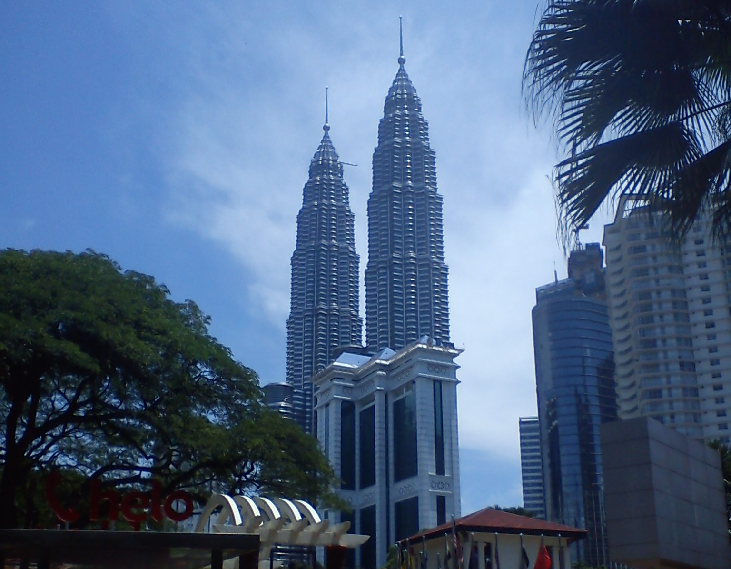
4. One of Malaysia's key attractions is its extreme contrasts. Towering skyscrapers look down upon wooden houses built on stilts, and five-star hotels sit several metres away from ancient reefs. For the perfect holiday full of surprises, eclectic cultures and natural wonders, the time is now, the place is Malaysia.

Slide 16
I’ll Tell You What to Draw

Slide 17
Typhoon

