Slide 1
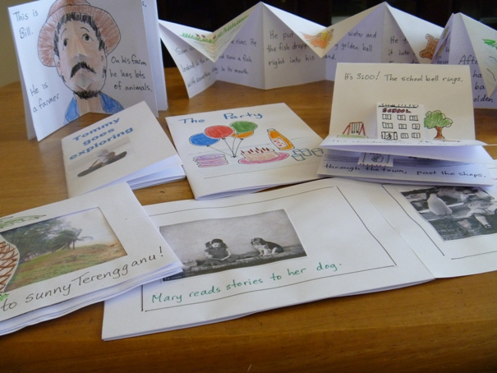
Making Little Books
A medium for Creativity and Story Telling
Notes:
We all love ‘little’ things – they are cute, and portable, and don’t cost much. Students and teachers alike enjoy making and having these little books. They are easy to make, fun to write in, and great to share.

Slide 2
THE little book
Made from a single sheet of paper
No need for staples, glue, sticky tape
Can be quickly and easily created by anyone
Can be adapted into pop-up book
Can be created on the computer in Word
Can be photocopied (one side of paper)
Sometimes called “hotdog book”, “origami book” “Poof! book” ...
Notes:
The advantages of this style of little book are many:
It is made from a single piece of paper – it can even be (one-sided) re-cycled paper.
You don’t need any extra equipment or materials.
Anyone can make one – even young children, and the elderly!
The basic little book is only the starting point. For the extra creative it can go on to become something very exciting.
The contents of the book can be created on the computer in Word, giving a very neat finish and meaning it’s easy to produce several copies on the printer.
Because it is only on one side of the paper, the book can also be opened out and scanned or photocopied making it easy to produce several copies of a student’s work for others to enjoy.
We didn’t invent the little book. You can find it in many places on the Internet under various names. It is sometimes called the ‘hotdog book’ because at one stage in its making it looks like a hotdog roll. Others call it the ‘origami book’ because it is folded. Others call it the “Poof!” book because it suddenly appears as a book almost magically.

Slide 3
The little book has front and back cover, and six pages. It can be made with A3 paper, or A4 paper.
Notes:
This is what a newly folded little book looks like. There is a front and back cover, and three double pages inside. It can be made from any size of paper. Paper that is not in the same format as A3 or A4 will simply give a different format book. For a pop-up book the paper needs to be of reasonable quality.

Slide 4
You need:
pens/pencils
scissors
A4 or A3 paper
Notes:
All you need is a desk/table or flat surface to work on, a piece of paper, a pair of scissors (briefly!), and writing or drawing materials.

Slide 5
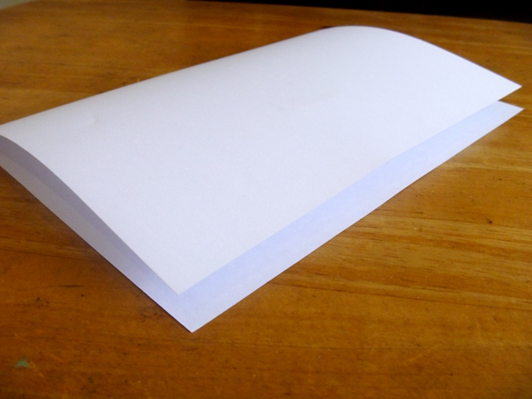
Step 1:
Fold the paper in half
Notes:
Firstly, fold the paper neatly in half, and crease the fold.

Slide 6
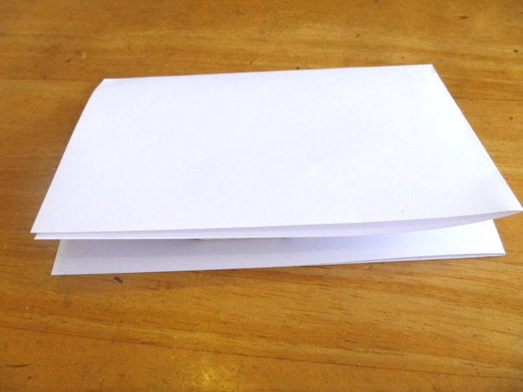
Step 2:
Fold the paper in half again
Notes:
Secondly, fold the paper again, being careful to make sure the edges line up neatly, and crease the fold well.

Slide 7
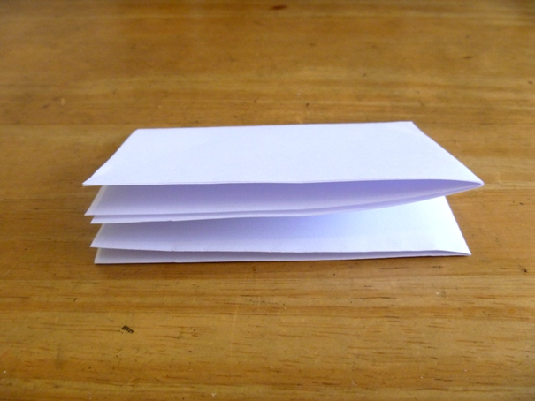
Step 3:
Fold the paper in half a third time
Notes:
Thirdly, fold the paper one more time. At this stage younger students may need assistance to make sure they can complete a neat fold.

Slide 8
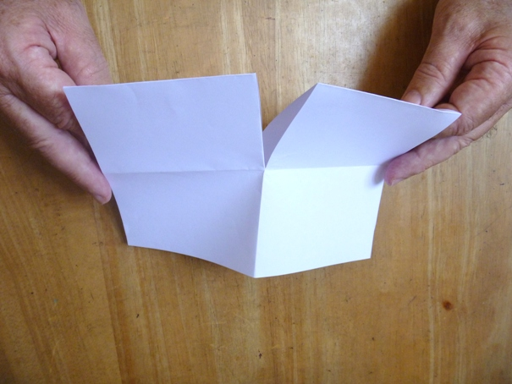
Step 4:
Unfold as far as the first fold
Cut down to the fold mark
from the fold edge
Notes:
Now, unfold back to the first fold.
Take the scissors and cut from the folded edge to the fold mark half way through. Again, young children will need extra supervision at this point.
As this is the only cut (unless you are making pop-up books), in a classroom situation a few pairs of scissors can be passed around and then removed.

Slide 9
Step 5:
Fold
Cut section
Unfold, and re-fold the other way
Notes:
Open the paper, and re-fold it the other way – keeping the same side of the paper on the outside. (Remember this can be done on re-cycled paper and the used side needs to stay inside.) If students open the paper and fold it outwards the other way then the next step will not work.
The paper is now folded longways, with the small cut section at the top as shown.

Slide 10
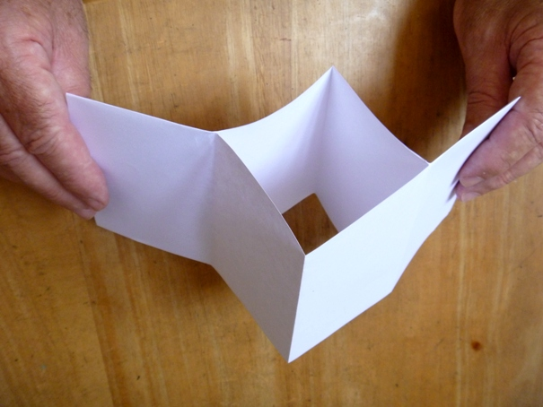
Hold the two ends ...
... and push them together.
Notes:
This is when the ‘magic’ happens. Hold the two ends and push them together as shown. The cut section will open a hole in the middle.

Slide 11
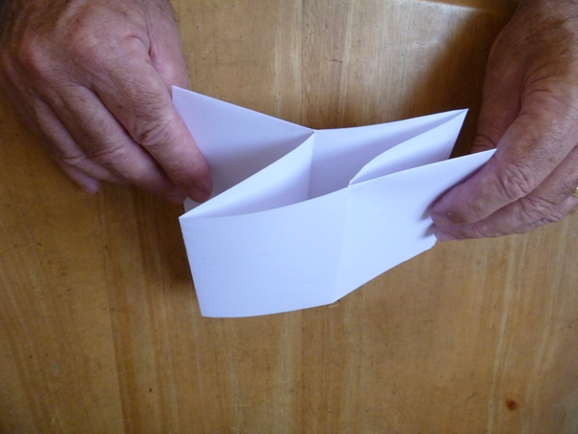
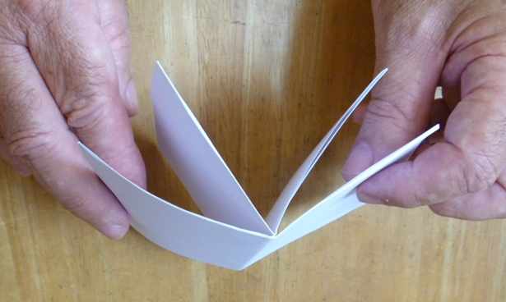
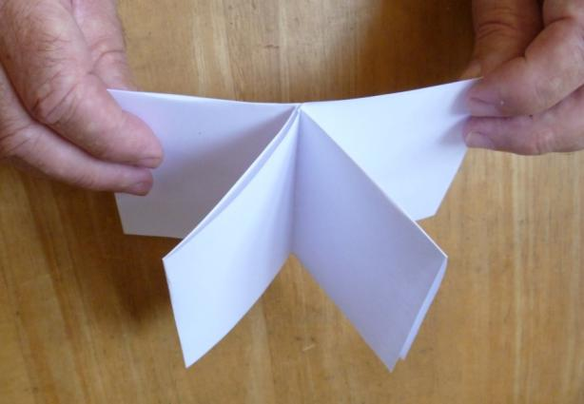
And there it is!
Notes:
Push until the paper folds right up into a little book. Bring the outside pages around to form the covers, and press the folds neatly into place.

Slide 12
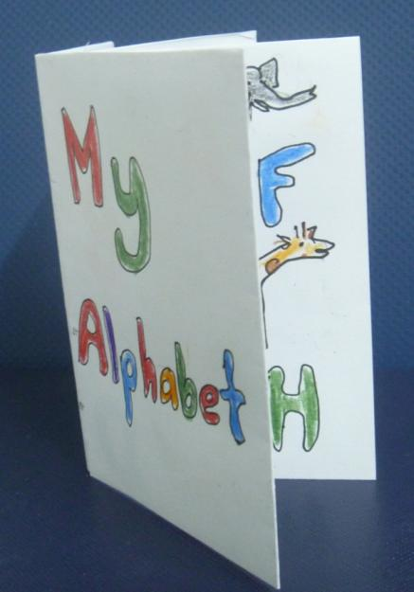
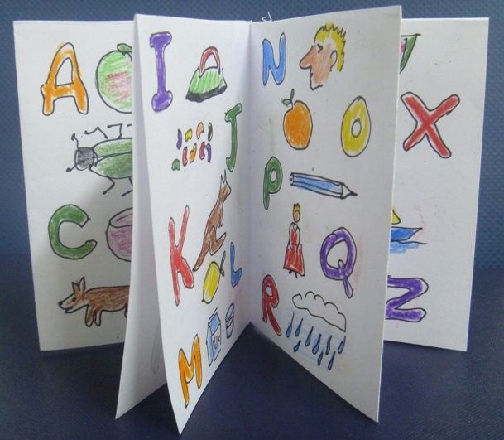
Now ... write, draw
Notes:
Now it’s time to be creative and fill the book.
Make sure young students especially are holding the book the right way up and start working from the front – sometimes they accidently start on the back cover.
The book can be used in ‘landscape’ format.
It can be used to write a story, explain a method, include an album of pictures, catalogue some items, explain an idea … the possibilities are only limited by the need to be brief! Students need to spend a moment to plan what they will put on each page.

Slide 13
Basic Story Writing
Introduce your characters with descriptions of physical and personality traits, their surroundings, and those with whom they come in contact.
Create a problem/conflict. This could be between two people, an internal conflict, or one in which the main character overcomes an obstacle in the outside world.
Write the climax of the story, which will include the main character(s) coming face to face with the conflict.
Show how your character(s) resolves the problem, and what happens next.
Notes:
If this is a story-writing lesson, remind students (of what they have already been taught …) about the basis of a story. The little book has six small internal pages. The first two pages could provide characters and setting, and possibly the conflict. The climax should be reached by the fourth page, and the resolution could happen on the last two.

Slide 14
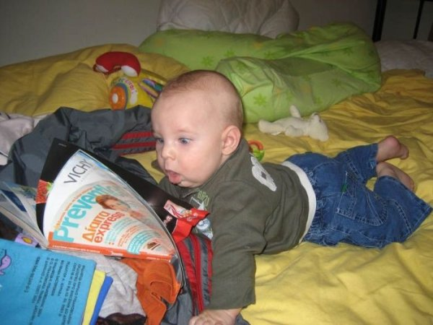
Really little kids love books and stories, but they don’t really need a storyline (problem and solution), and they don’t want anything scary!
Notes:
Student teachers making little book stories for very young children could be reminded that a story can be very simple and does not require much excitement.

