Slide 1
Motivation – why read?
Reading in English for Young Learners in Malaysia
Session 1b

Slide 2
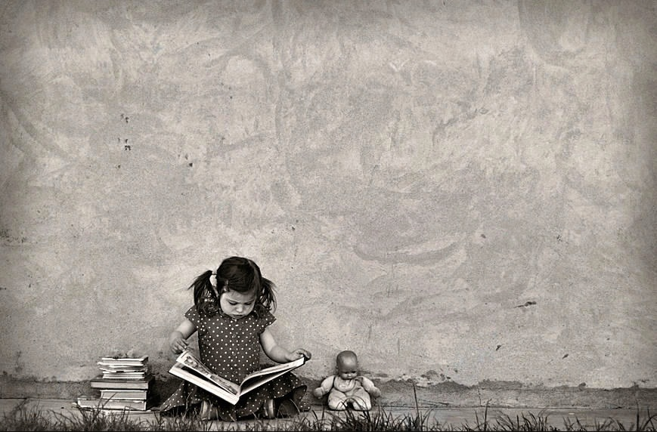
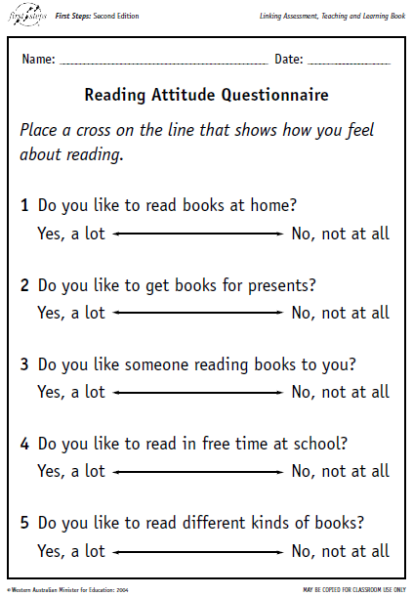
Why do children want to read?

Slide 3
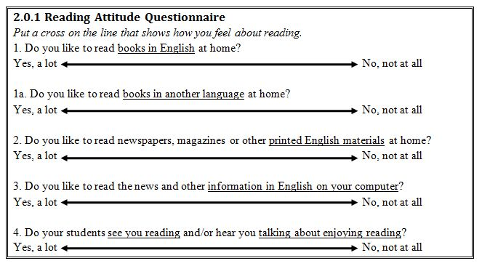
Why do you read – in English?

Slide 4
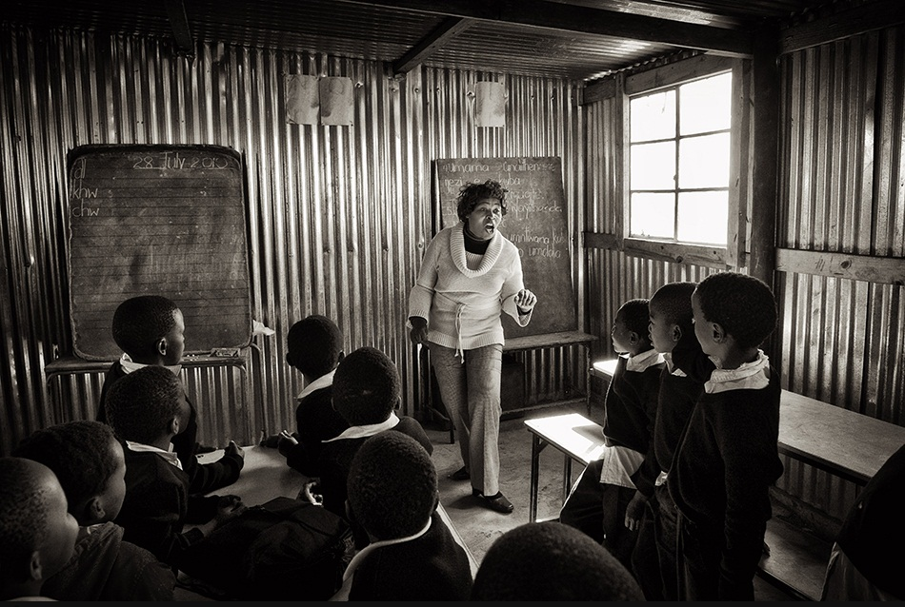
Motivating Children to Read
Discuss:
What factors can cause a child to have poor motivation to learn to read (at all / in English)?
Discuss what could be done about these problems.
Think of a solution for each.

Slide 5
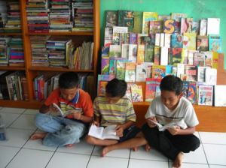
“Why Read?” by Christopher Fernandez
It is terribly disappointing to often read in the media that Malaysia is hardly considered as a reading society.
http://www.freemalaysiatoday.com/2011/08/13/why-read/

